Slide 1

Container Orchestration
Technologies
Introduction into Kubernetes, Docker Swarm, Managed Services & Enterprise Platforms
May 2026

Slide 2
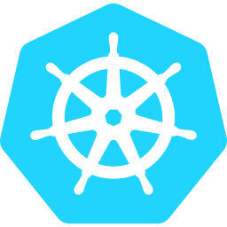

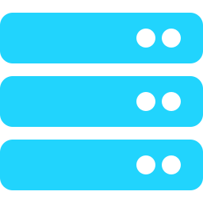
Core Orchestration Platforms
Kubernetes
Docker Swarm
Apache Mesos
Industry Standard
Simple & Native
Mixed Workloads
Most widely adopted orchestration platform
Massive ecosystem & community
Hybrid and multicloud support
Highly extensible (CRDs, Operators, GitOps)
Docker's built-in clustering tool
Simpler than K8s, lower learning curve
Best for small teams & simple deployments
Less feature-rich at scale
Distributed systems kernel
Paired with Marathon for containers
Handles containers + VMs + big data
Highly scalable for large clusters

Slide 3

Managed Kubernetes Services
Amazon EKS
AWS-managed K8s with deep AWS integration
Google GKE
Most mature managed K8s, early pioneer
Cloud & Enterprise
Kubernetes
Azure AKS
Microsoft's managed K8s platform
IBM Cloud K8s
IBM's managed Kubernetes offering
Enterprise Platforms
Reducing operational overhead
with managed platforms
Red Hat OpenShift
Enterprise K8s with strong security & CI/CD
VMware Tanzu
K8s management across on-prem and cloud
SUSE Rancher
Multi-cluster K8s for hybrid/multicloud

Slide 4
Technology Landscape at a Glance
Category | Technologies | Best For
Core Orchestrators | Kubernetes, Docker Swarm, Apache Mesos | Running containers at scale, automation
Managed Kubernetes | EKS, GKE, AKS, IBM Cloud K8s | Reduced ops overhead for teams
Enterprise Platforms | OpenShift, Tanzu, Rancher | Governance, security, large enterprises
Market Adoption
Key Insight
Kubernetes is the clear industry leader, with most cloud and enterprise platforms built directly on top of it. Whether managed (EKS, GKE, AKS) or extended (OpenShift, Tanzu, Rancher), the K8s ecosystem dominates container orchestration across all segments.

Slide 5
Kubernetes
Container Orchestration at Scale

Slide 6
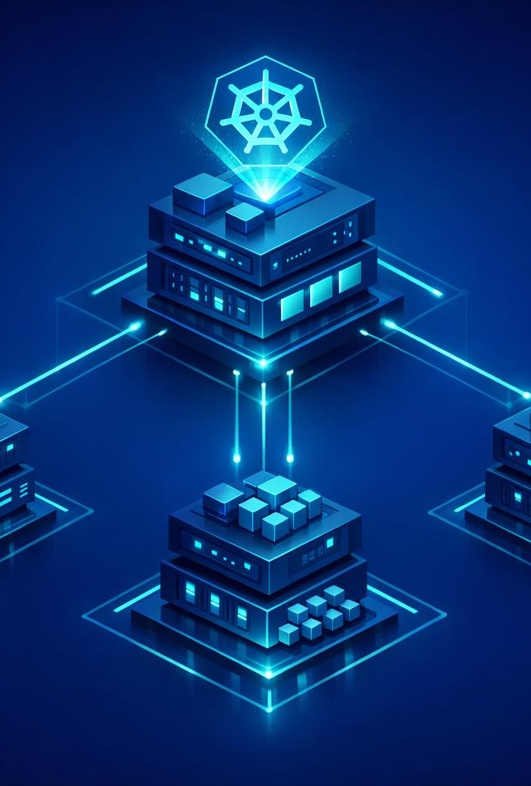

Kubernetes Architecture
How the control plane and worker nodes collaborate
Control Plane
API Server
Central gateway for all cluster operations
etcd
Distributed key-value store for cluster state
Scheduler
Assigns pods to nodes based on resources
Controller Mgr
Maintains desired state via control loops
Worker Nodes
kubelet
Agent ensuring containers run in pods
kube-proxy
Network proxy managing service routing
Container Runtime
Runs containers (containerd, CRI-O)

Slide 7
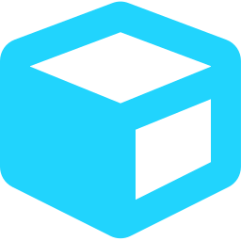




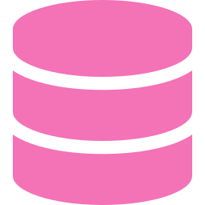

Core Kubernetes Components
Pods
Services
Deployments
Smallest deployable unit — one or more containers sharing network and storage
Stable network endpoint that routes traffic to a set of pods via selectors
Declarative updates for pods and ReplicaSets with rolling update strategy
Config & Secrets
Namespaces
Persistent Volumes
Decouple configuration and sensitive data from container images
Virtual clusters for resource isolation and multi-tenancy within a cluster
Storage resources decoupled from pod lifecycle for stateful workloads
Each component works together to provide self-healing, auto-scaling container orchestration

Slide 8
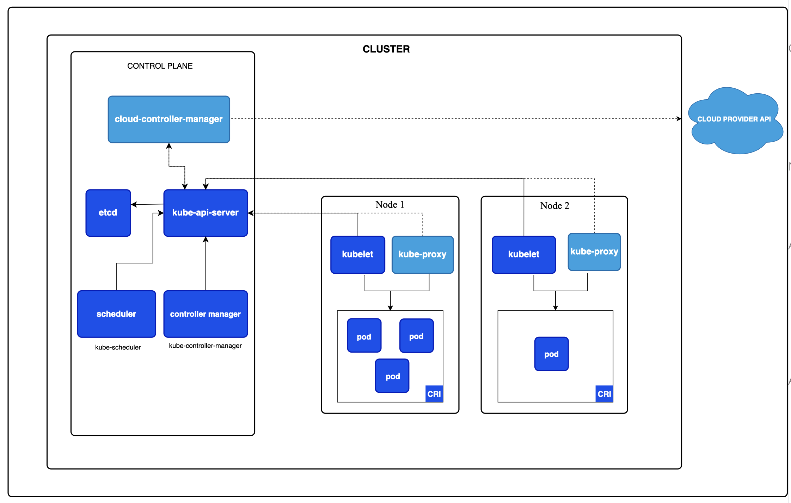

Slide 9
Kubernetes Cluster
Control-Plane - Brain
Worker Nodes - Muscles
Master
Container1
Container1
Container2
Container2
Container3
Container3

Slide 10





Kubernetes in Practice
Common use cases and deployment patterns
Microservices Orchestration
CI/CD & GitOps
Deploy, manage, and scale independent services with service discovery, load balancing, and health monitoring built in.
Automate deployments with rolling updates, canary releases, and rollbacks. Integrate with ArgoCD, Flux, and Jenkins.
Auto-Scaling Workloads
Hybrid & Multi-Cloud
Horizontal Pod Autoscaler adjusts replicas based on CPU, memory, or custom metrics. Cluster autoscaler adds nodes.
Run consistent workloads across on-premises, AWS, Azure, and GCP with federation and service mesh integration.
Kubernetes powers 96% of organizations using containers in production (CNCF Survey 2024)

Slide 11



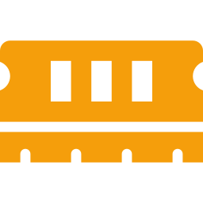

Prerequisites & Setup
What you need before enabling Kubernetes
macOS
macOS 12 (Monterey) or later recommended
Docker Desktop
Version 4.x+ installed and running
Memory
Minimum 4 GB RAM allocated to Docker (6 GB+ recommended)
Disk Space
At least 20 GB free for images and volumes
Tip: Open Docker Desktop > Settings > Resources to allocate CPU and memory before enabling Kubernetes.

Slide 12

Enable Kubernetes in Docker Desktop
Step-by-step walkthrough
1
Open Docker Desktop
4
Enable Kubernetes
Click the Docker whale icon in your macOS menu bar, or launch from Applications.
Check the box "Enable Kubernetes" and click "Apply & Restart".
2
Go to Settings
5
Wait for Installation
Click the gear icon (top-right) to open the Settings panel.
Docker will download K8s components. The status bar shows "Kubernetes running" when ready (2-5 min).
3
Navigate to Kubernetes
In the left sidebar, click "Kubernetes" under the Settings menu.
Both Docker and Kubernetes icons in the menu bar should show green when ready.

Slide 13

Verify & Get Started
Terminal commands to confirm your cluster is running
Check kubectl version
$ kubectl version --client
Client Version: v1.29.x
Verify cluster is running
$ kubectl cluster-info
Kubernetes control plane is running at
https://127.0.0.1:6443
List cluster nodes
$ kubectl get nodes
NAME STATUS ROLES
docker-desktop Ready control-plane
Deploy your first app
$ kubectl create deployment nginx --image=nginx
kubectl expose deployment nginx --port=80 --type=NodePort
deployment.apps/nginx created
service/nginx exposed
Check running pods
$ kubectl get pods
NAME READY STATUS AGE
nginx-xxx-yyy 1/1 Running 10s

Slide 14
YAML for Kubernetes
The Language Behind Every Kubernetes Manifest

Slide 15
YAML Lists & Dictionaries
Two core data structures — ordered sequences and key-value maps
Lists / Arrays (ordered sequence)
Dictionaries / Maps (key → value)
fruits:
- apple
- banana
- cherry
Each - (dash + space) marks one item in the list
person:
name: Alice
age: 30
city: New York
Each indented key: value pair is a property of the parent
How a Dictionary Maps Keys to Values
person
❯
❯
❯
name
→
Alice
← string
← integer
← string
age
→
30
city
→
New York
KEYS
VALUES
Key Insight: Lists use - (dash) for ordered items • Dictionaries use key: value for named properties

Slide 16
Combining Lists & Dictionaries
The real power of YAML — nesting lists inside dictionaries and vice versa
List of Dictionaries
Dictionary with Lists
employees:
- name: Alice
role: Engineer
active: true
- name: Bob
role: Designer
active: false
Each - starts a new dictionary item in the list
team:
name: Platform Team
members:
- Alice
- Bob
- Charlie
tools:
- Docker
- Terraform
A dict can have multiple list-valued keys
Visual: How Lists & Dicts Compose
employees
(list)
❯
❯
[0] name: Alice | role: Engineer
← dict (each list item is a full dictionary)
[1] name: Bob | role: Designer
← dict (same structure, different data)
Pattern: A - followed by key: value means "a list where each item is a dictionary" — the most common YAML combo

Slide 17
XML vs JSON vs YAML
Same data, three formats — representing a Kubernetes-style container definition
XML
JSON
YAML ✓
<container>
<name>nginx</name>
<image>nginx:1.25</image>
<ports>
<port>
<containerPort>
80
</containerPort>
</port>
</ports>
</container>
11 lines
{
"name": "nginx",
"image": "nginx:1.25",
"ports": [
{
"containerPort": 80
}
]
}
9 lines
name: nginx
image: nginx:1.25
ports:
- containerPort: 80
4 lines
Feature Comparison
Feature XML JSON YAML
Readability Low (verbose tags) Medium (brackets) High (minimal syntax)
Comments ✓ Supported ✗ Not supported ✓ Supported (#)
Data types String only String, number, bool String, number, bool
K8s usage Not used kubectl output only All manifests ✓

Slide 18
YAML Key-Value Pairs
The building block of every YAML file — and why indentation is everything
Simple Key-Value Pairs
Nested Keys (Indentation = Structure)
name: my-app
image: nginx:1.25
replicas: 3
enabled: true
↑ key: value (space after colon is required)
metadata:
name: my-pod
labels:
app: web
env: production
↑ 2-space indent creates parent → child hierarchy
⚠ Why Spaces Matter in YAML
✗ Common Mistakes
name:my-app ← missing space after colon
name: my-app ← tabs are not allowed
metadata:
name: my-pod ← missing indent (not nested)
✓ Golden Rules
• Always use spaces, never tabs
• 2 spaces per indent level (K8s standard)
• One space after the colon is mandatory
• Indentation defines structure, not braces or tags
Pro Tip: Most YAML errors in Kubernetes are caused by incorrect indentation — use an editor with YAML linting enabled

Slide 19
Nested Structures — Deep Hierarchy
Real configs go multiple levels deep — indentation is the only way to know where you are
Company Config — 4 Levels Deep
Hierarchy Tree View
company:
name: Acme Corp
departments:
- name: Engineering
lead: Alice
teams:
- name: Backend
size: 5
languages:
- Python
- Go
- name: Frontend
size: 3
languages:
- TypeScript
- React
company
Level 0
↓
departments
Level 1
↓
Engineering
Frontend
Level 2
↓
Backend
Level 3
↓
Python
Go
Level 4
Reading Tip
Count the leading spaces to know your depth:
0 sp = root • 2 sp = child • 4 sp = grandchild ...
Key Takeaway: YAML nests dicts inside lists inside dicts — endlessly. Indentation is the only delimiter, so every 2-space shift changes meaning.

Slide 20
Ordered Lists vs Unordered Dictionaries
Position matters in lists, but not in dictionaries — a critical difference
List = Ordered (position matters)
Dictionary = Unordered (key matters)
steps:
- build
- test
- deploy
≠
steps:
- deploy
- build
- test
person:
name: Alice
age: 30
city: NYC
=
person:
city: NYC
name: Alice
age: 30
⚠ Different order = different meaning!
Deploying before building would fail the pipeline
✓ Same data — order doesn't matter
Values are looked up by key name, not position
Key Differences at a Glance
Property List (Array) Dictionary (Map)
Ordering Preserved — position is data Not guaranteed — key is the lookup
Duplicates Allowed — same value can appear twice Keys must be unique
Access By index steps[0] By key person.name
Use when Sequence matters (steps, args, ports) Naming matters (labels, config)
Why This Matters: Swapping two items in a list changes behavior (e.g., deploy runs before build). Swapping two keys in a dictionary is cosmetic — the result is identical.

Slide 21
YAML Fundamentals
Core syntax every Kubernetes user needs to know
Key-Value Pairs
Nested Maps (Indentation = Structure)
# Simple key-value
apiVersion: v1
kind: Pod
replicas: 3
metadata:
name: my-app
labels:
app: web-server
Lists (Sequences)
Comments & Data Types
containers:
- name: nginx
- name: redis
- name: postgres
# This is a comment
name: "nginx" # string
replicas: 3 # integer
enabled: true # boolean
Key Rules for Kubernetes YAML
Use spaces (not tabs) for indentation • 2 spaces per indent level is standard • Strings don't always need quotes • Lists use dash-space prefix • Every manifest needs apiVersion, kind, metadata, and spec
YAML = "YAML Ain't Markup Language" — a human-readable data serialization format used for all Kubernetes configuration

Slide 22
Example 1: Pod Manifest
The simplest Kubernetes resource — running a single container
# nginx-pod.yaml
apiVersion & kind
Tells K8s which API group and resource type to use. Every manifest starts here.
apiVersion: v1
kind: Pod
metadata:
name: nginx-pod
labels:
app: nginx
spec:
containers:
- name: nginx
image: nginx:1.25
ports:
- containerPort: 80
metadata
Identifies the resource with name and labels. Labels enable selectors and grouping.
spec.containers
Defines what runs inside the pod. Each container needs a name, image, and optionally ports.
Apply it
$ kubectl apply -f nginx-pod.yaml
pod/nginx-pod created

Slide 23
Example 2: Deployment
Managing replicas, rolling updates, and self-healing with declarative YAML
# nginx-deployment.yaml
replicas: 3
Run 3 identical pod copies. K8s auto-restarts any that fail to maintain this count.
apiVersion: apps/v1
kind: Deployment
metadata:
name: nginx-deployment
spec:
replicas: 3
selector:
matchLabels:
app: nginx
strategy:
type: RollingUpdate
template:
metadata:
labels:
app: nginx
spec:
containers:
- name: nginx
image: nginx:1.25
ports:
- containerPort: 80
selector + matchLabels
Links the Deployment to its pods. Must match template.metadata.labels exactly.
strategy: RollingUpdate
Zero-downtime updates — replaces pods one at a time. Alternative: Recreate (all at once).
template (Pod spec)
A pod blueprint nested inside the Deployment. Same structure as a standalone Pod manifest.

Slide 24
Example 3: Service & ConfigMap
Exposing pods to the network and externalizing configuration
Service — Expose Pods to Traffic
ConfigMap — Externalize Config
# nginx-service.yaml
apiVersion: v1
kind: Service
metadata:
name: nginx-service
spec:
type: NodePort
selector:
app: nginx
ports:
- port: 80
targetPort: 80
nodePort: 30080
# app-config.yaml
apiVersion: v1
kind: ConfigMap
metadata:
name: app-config
data:
DATABASE_HOST: "db.example.com"
DATABASE_PORT: "5432"
LOG_LEVEL: "info"
---
# Reference in a Pod:
envFrom:
- configMapRef:
name: app-config
Service Types: ClusterIP (internal only, default) • NodePort (external via node port 30000-32767) • LoadBalancer (cloud LB provisioned automatically)
ConfigMap: Stores non-sensitive config as key-value pairs. Inject via envFrom or volume mounts. Use Secrets for passwords.

Slide 25
Understanding Pods
The Fundamental Building Block of Kubernetes

Slide 26
Why Pods, Not Just Containers?
The abstraction layer that makes Kubernetes powerful
✗ Running Containers Directly
✓ Pod Abstraction Solves This
No shared networking
Containers need separate IPs and explicit port mapping to talk to each other
No co-scheduling guarantee
Related containers may land on different nodes, adding latency and complexity
No shared storage
Each container has isolated filesystem; sharing files requires external mounts
No lifecycle coordination
Starting, stopping, and restarting tightly coupled containers must be managed manually
Shared network namespace
All containers in a pod share one IP and can reach each other via localhost
Co-located on same node
K8s scheduler guarantees all containers in a pod run on the same worker node
Shared volumes
Containers within a pod can mount the same volume for seamless file sharing
Unified lifecycle
All containers start, stop, and restart together as a single atomic unit
Think of a Pod as a "logical host" — like a small VM that groups tightly coupled containers with shared resources

Slide 27
Anatomy of a Pod
What lives inside a Pod and how containers share resources
Pod (10.244.1.5)
Container 1
nginx:1.25
Port 80
Container 2 (Sidecar)
fluentd:latest
Log collector
Shared Network
Same IP, localhost
Shared Volumes
emptyDir, PVC
Shared IPC
Inter-process comms
Volume: /var/log (mounted by both containers)
Pause Container (hidden infra container that holds the network namespace)
Diagram: Containers within a Pod share the same network namespace (IP), storage volumes, and IPC namespace

Slide 28
One Container Per Pod — The Standard
In real-world production, ~95% of pods run a single container
1 : 1
Container-to-Pod ratio
Most common pattern
When to Stick to Single Container
Microservice with independent scaling
Each service scales on its own — scale the API separately from the database
Different release cycles
Deploy frontend and backend independently without restarting the other
Different resource profiles
CPU-heavy vs memory-heavy containers need different node types and limits
Independent failure domains
A crash in one service shouldn't take down another — keep blast radius small
Simpler debugging and monitoring
Logs, metrics, and health checks are cleaner when each pod has one responsibility
Pod
App Container
my-api:v2.1
Rule of Thumb: If you can answer "Can this container be deployed and scaled independently?" with Yes → give it its own Pod

Slide 29
Multi-Container Pod Patterns
When and why to run 2–3 containers in a single Pod
Sidecar
Helper container that extends or enhances the main app without modifying it.
Real-World Examples:
• Fluentd / Filebeat log shipper
• Istio Envoy proxy
• Vault agent for secrets
Diagram: [App] → writes logs → [Sidecar] → ships to logging backend
Ambassador
Proxy container that simplifies how the app connects to external services.
Real-World Examples:
• Redis proxy for sharding
• Cloud SQL Auth Proxy
• AWS App Mesh proxy
Diagram: [App] → localhost:3306 → [Proxy] → Cloud DB
Adapter
Transforms output from the main container into a standardized format.
Real-World Examples:
• Prometheus exporter
• Log format normalizer
• Data transformer sidecar
Diagram: [App] → custom metrics → [Adapter] → /metrics endpoint
Key Principle: Only add a second container when it truly cannot function independently and must share the Pod's network or storage. The helper must serve the main container, not the other way around.

Slide 30
Containers Per Pod in Production
What real-world clusters actually look like — and practical limits
~95%
1 container per pod
Standard microservices
~4%
2 containers per pod
App + sidecar (logging/proxy)
~1%
3+ containers per pod
Service mesh + logging
Max
No hard limit
But 4+ is a red flag
Decision Guide: Single vs Multi-Container
Question Single Pod Multi-Container
Can they scale independently? ✓ Yes ✗ No
Must they share localhost networking? ✗ No ✓ Yes
Do they share files on a common volume? ✗ No ✓ Yes
Must they start/stop together as one unit? ✗ No ✓ Yes
In service mesh environments (Istio/Linkerd), most pods have exactly 2 containers: the app + the Envoy sidecar proxy

Slide 31
Hands-On 1: Create Your First Pod
Write and deploy your first Pod manifest from scratch
# my-first-pod.yaml
Step 1: Create the File
Open your terminal and create a new file called my-first-pod.yaml using any text editor.
apiVersion: v1
kind: Pod
metadata:
name: hello-pod
labels:
app: hello
tier: frontend
spec:
containers:
- name: hello
image: nginx:1.25
ports:
- containerPort: 80
Step 2: Apply the Manifest
Run kubectl apply -f my-first-pod.yaml to create the Pod in your cluster.
Step 3: Verify the Pod
Run kubectl get pods to confirm your Pod is running. Check status shows Running.
Try it
$ kubectl get pods
NAME READY STATUS AGE
hello-pod 1/1 Running 10s

Slide 32
Hands-On 2: Pod with Env Variables
Configure containers with environment variables and named ports
# env-pod.yaml
Step 1: Add Environment Variables
Define env vars under the container spec using name-value pairs.
apiVersion: v1
kind: Pod
metadata:
name: env-demo
labels:
app: env-demo
spec:
containers:
- name: web
image: nginx:1.25
ports:
- containerPort: 80
name: http
env:
- name: APP_ENV
value: "production"
- name: LOG_LEVEL
value: "info"
Step 2: Apply and Inspect
Apply the manifest, then run kubectl exec env-demo -- env to verify variables are set.
Step 3: Check Named Ports
Run kubectl describe pod env-demo and look for the Ports section showing http:80/TCP.
Verify it
$ kubectl exec env-demo -- printenv APP_ENV
production

Slide 33
Hands-On 3: Pod with Resource Limits
Control CPU and memory allocation with requests and limits
# resource-pod.yaml
Step 1: Set Resource Requests
Requests define the minimum guaranteed resources. The scheduler uses these for placement.
apiVersion: v1
kind: Pod
metadata:
name: resource-demo
spec:
containers:
- name: stress-test
image: nginx:1.25
resources:
requests:
memory: "64Mi"
cpu: "250m"
limits:
memory: "128Mi"
cpu: "500m"
ports:
- containerPort: 80
Step 2: Set Resource Limits
Limits cap maximum usage. Exceeding memory limits triggers an OOMKill; CPU gets throttled.
Step 3: Inspect Allocations
Run kubectl describe pod resource-demo and check the Requests and Limits sections.
Verify it
$ kubectl describe pod resource-demo | grep -A4 Limits
cpu: 500m, memory: 128Mi

Slide 34
Hands-On 4: Pod with Health Probes
Add liveness and readiness probes to ensure container health
# health-pod.yaml
Step 1: Add Liveness Probe
Liveness probes detect stuck containers. K8s restarts the container if the probe fails.
apiVersion: v1
kind: Pod
metadata:
name: health-demo
spec:
containers:
- name: web
image: nginx:1.25
ports:
- containerPort: 80
livenessProbe:
httpGet:
path: /
port: 80
initialDelaySeconds: 5
periodSeconds: 10
readinessProbe:
httpGet:
path: /
port: 80
initialDelaySeconds: 3
periodSeconds: 5
Step 2: Add Readiness Probe
Readiness probes control traffic routing. The Pod only receives traffic when ready.
Step 3: Watch Probe Status
Run kubectl describe pod health-demo and check the Events section for probe activity.
Monitor it
$ kubectl describe pod health-demo | grep -A2 Liveness
Liveness: http-get http://:80/ delay=5s

Slide 35
Hands-On 5: Multi-Container Pod
Deploy a sidecar pattern with shared volume between containers
# sidecar-pod.yaml
Step 1: Define Shared Volume
Create an emptyDir volume that both containers can mount to exchange data.
apiVersion: v1
kind: Pod
metadata:
name: sidecar-demo
spec:
volumes:
- name: shared-logs
emptyDir: {}
containers:
- name: app
image: nginx:1.25
volumeMounts:
- name: shared-logs
mountPath: /var/log/nginx
- name: log-reader
image: busybox:1.36
command: ["sh","-c","tail -f
/logs/access.log"]
volumeMounts:
- name: shared-logs
mountPath: /logs
Step 2: Mount in Both Containers
Mount the volume at different paths in each container. Nginx writes logs, sidecar reads them.
Step 3: Verify Both Containers
Run kubectl get pod sidecar-demo to confirm READY shows 2/2, meaning both containers run.
Verify it
$ kubectl logs sidecar-demo -c log-reader
[tailing /logs/access.log...]

Slide 36
Links to access Hands-on Guide
https://atul-matkawala-232.github.io/K8s-material/K8s-Replicaset/k8s-rc-replicaset-handson.html
https://atul-matkawala-232.github.io/K8s-material/k8s-service/k8s-services-handson.html
https://atul-matkawala-232.github.io/K8s-material/k8s-voting-app/k8s-voting-app-guide.html

